Slide 1


Slide 2

Session 1 - Makeup
Chaos Theory
TPC / ServNet / Auction Academy
Auto Auction- Industry Overview
Trade Associations

Slide 3
Session 1 - Makeup
Do as I say, not as I Do!
(Don’t slip on ice)
    Professors – Presenters – Staff – Administrators
    Students
    Etiquette - Professional Courtesy

Slide 4
Session 1 - Makeup
You “ARE” what you “ARE”
        Attire
        Attitude
        Demeanor

Slide 5
Session 1 - Makeup
Courtesy and Professionalism
        To yourself
        To your classmates
        To your presenters
            Social Events
            Dinners
            After Party

Slide 6
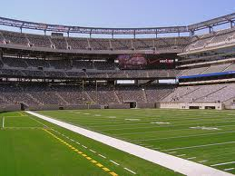
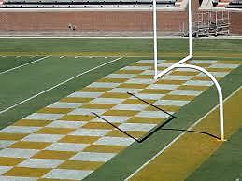
Session 1 - Makeup
Boundaries
Sidelines
End zone

Slide 7
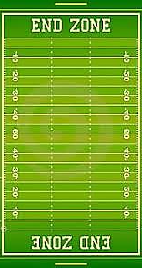
Session 1 - Makeup
Playing field
Expectations

Slide 8


Session 1 - Makeup

Slide 9
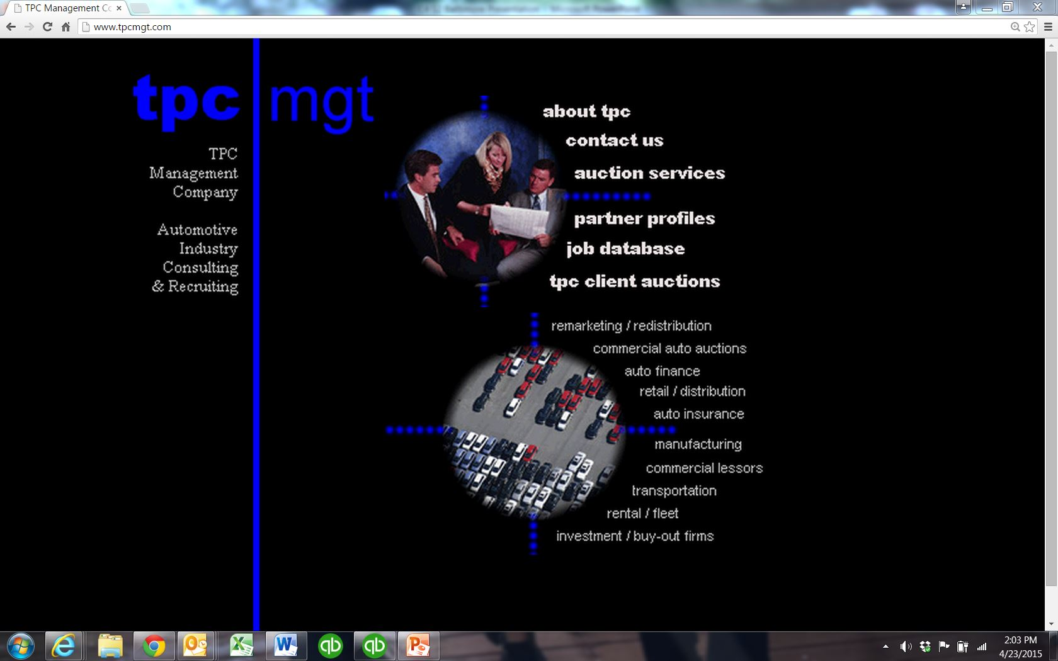
www.tpcmgt.com
Session 1 - Makeup

Slide 10
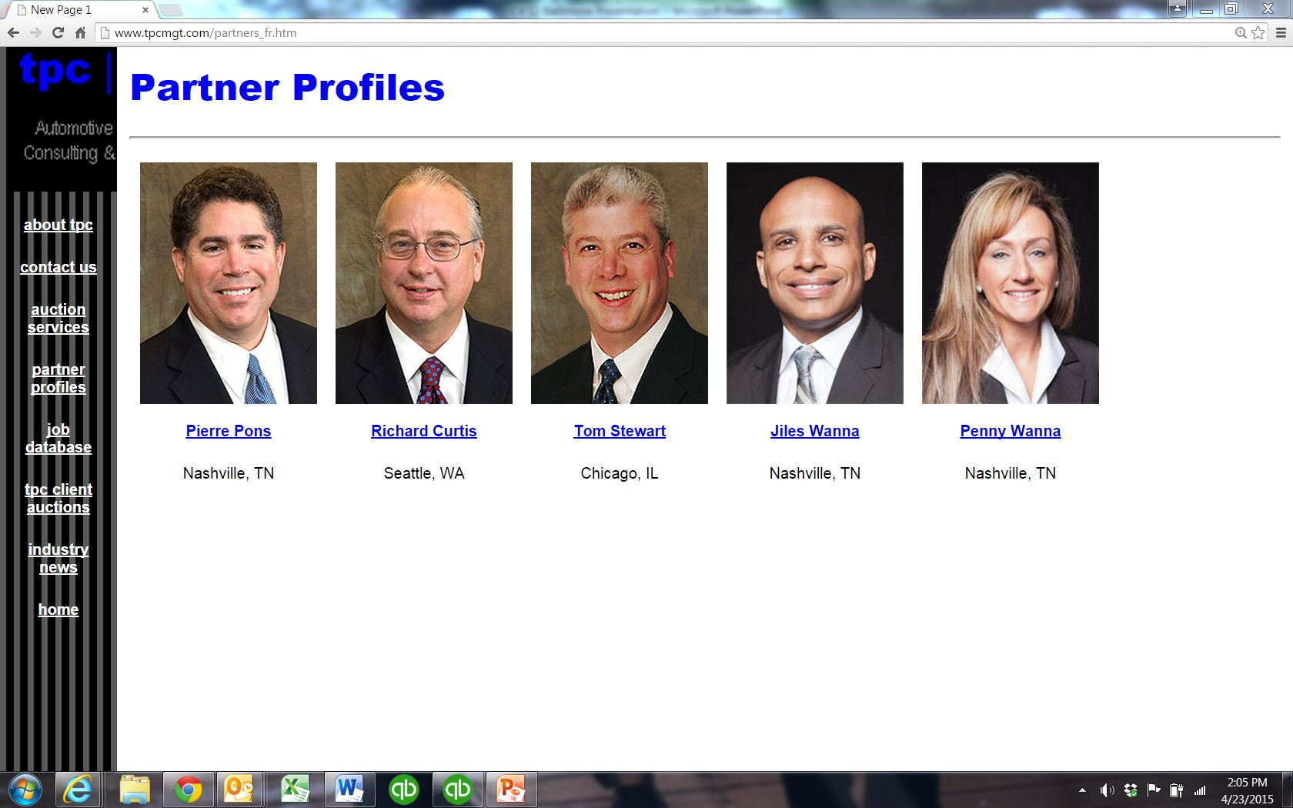
www.tpcmgt.com
Session 1 - Makeup

Slide 11
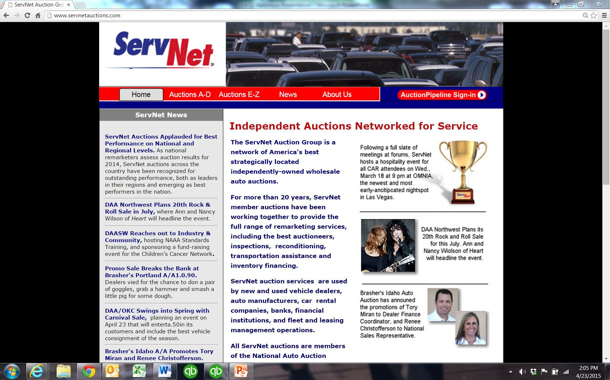
Session 1 - Makeup
www.servnetauctions.com

Slide 12
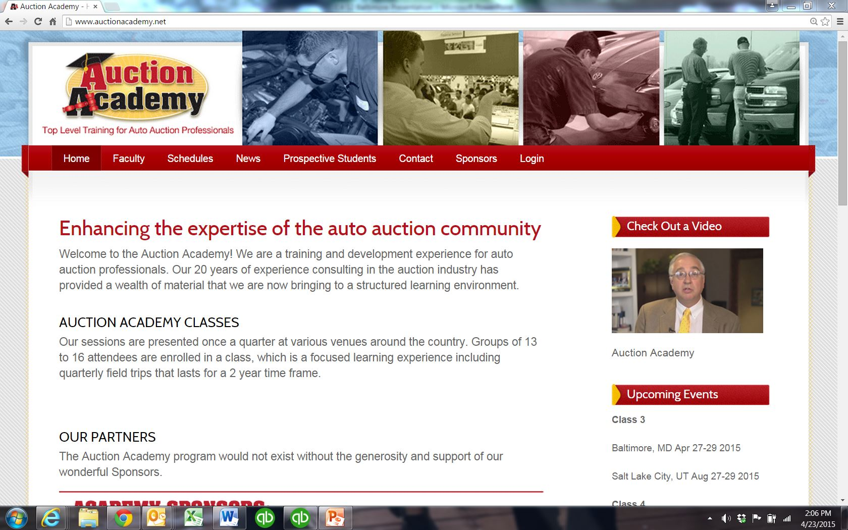
www.auctionacademy.net
Session 1 - Makeup

Slide 13






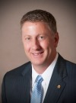
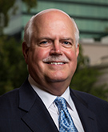
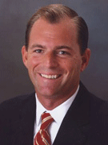
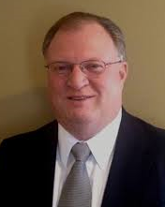
Session 1 - Makeup
Industry Trade Associations
Definition:
An association of people or companies in a particular business or trade, organized to promote their common interests.
Frank Hackett
Chief Executive Officer
Steve Jordan
Executive Vice President
Peter K. Welch
President
Michael J. Stanton
Vice President and COO
Tony W. Long
Executive Director

Slide 14


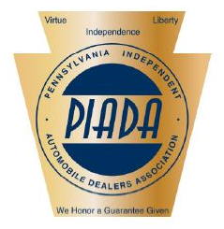


Session 1 - Makeup
Industry Trade Associations
Frank Hackett
Chief Executive Officer
Steve Jordan
Executive Vice President
Peter K. Welch
President
Michael J. Stanton
Vice President and COO
Tony W. Long
Executive Director
STATE ASSOCIATIONS

Slide 15



For Spokane
Session 1 - Makeup
Industry Conferences
NAAA Annual Convention
September 22-24, 2015
Orlando, FL.
Hilton Bonnet Creek
National Remarketing Conference – Used Car Week
November 16-20, 2015
Scottsdale, AZ
The Phoenician
Conference of Automotive Remarketing & Exhibition
March 16-17, 2016
Las Vegas, NV
Caesars Palace
NADA Convention & Expo
March 31-April 3, 2016
Las Vegas, NV

Slide 16

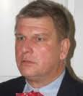
Todd August
Director of Wholesale Operations,
Avis Budget Group

Slide 17
Session 1 - Makeup
Industry Overview
Regular Members
Associate Members

Slide 18



Session 1 - Makeup
Industry Overview
334 members
72
62
200

Slide 19

HOMEWORK
Theory
Dirty Dozen
Chaos Theory
Chaos - is often defined as the complete absence of order, and consequently of information.

Slide 20
HOMEWORK
Theory
Dirty Dozen
Chaos Theory
Chaos - is often defined as the complete absence of order, and consequently of information.
“Structure breads spontaneity”
…Rob Bell Thursday, March 12th, 2015
“The fact that you can go off a trail is the fact that there IS a trail.”
…Rob Bell Thursday, March 12th, 2015

Slide 21
Session 1 - Makeup
Class 4 – Industry
Session 2 - Joint Session w/ class 3
Baltimore / DC
April 27-29, 2015
Tonight:
6:30pm Dinner – NAAA & Avis/Budget
room: Luray B/C
Tomorrow:
7:30am Departing hotel – NADA Academy
**BE ON TIME**

