Slide 1
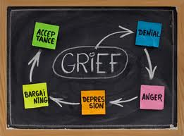
Stages of Grief
Grief has many stages. For most people this is what you go through if your grieving.

Slide 2
The Denial Stage
Denying is something everyone has done. Denial is where you don’t want to believe what has happened or you don’t want to take the blame for something you did

Slide 3
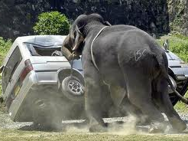
The Anger Stage
Everybody has gotten angry at least once in their lives. Some people, while grieving, get angry. And that’s perfectly fine, as long as they don’t harm people or objects.

Slide 4
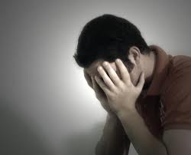
The Depression Stage
While grieving about 35-40% are depressed. 33% of those people will continue being depressed for a while.

Slide 5
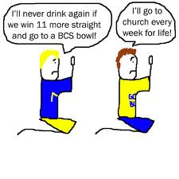
The Bargaining Stage
Some people will bargain. For instance, they’ll go to church every weekend because someone in their family died and the person who died went to church every week while you just stayed home.

Slide 6
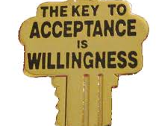
Lastly the Acceptance Stage
When you are almost done grieving, you accept. If something traumatic has happened, you know you can’t do anything about it. You just have to accept it. You can’t change what has happened.

