Slide 1
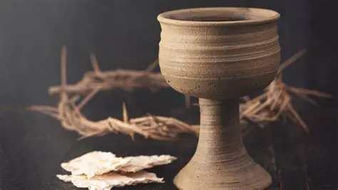
Communion

Slide 2
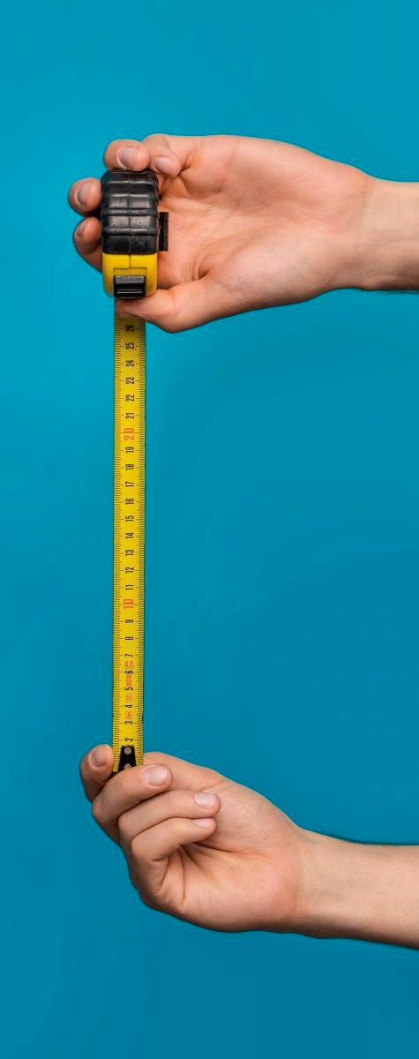
Communion
1 Corinthians 11:27-28
²⁸ But let a man examine himself, and so let him eat of the bread and drink of the cup. ²⁹ For he who eats and drinks in an unworthy manner eats and drinks judgment to himself, not discerning the Lord’s body.
0-5
Galatians 6:4
But let each one examine his own work…
0-5

Slide 3
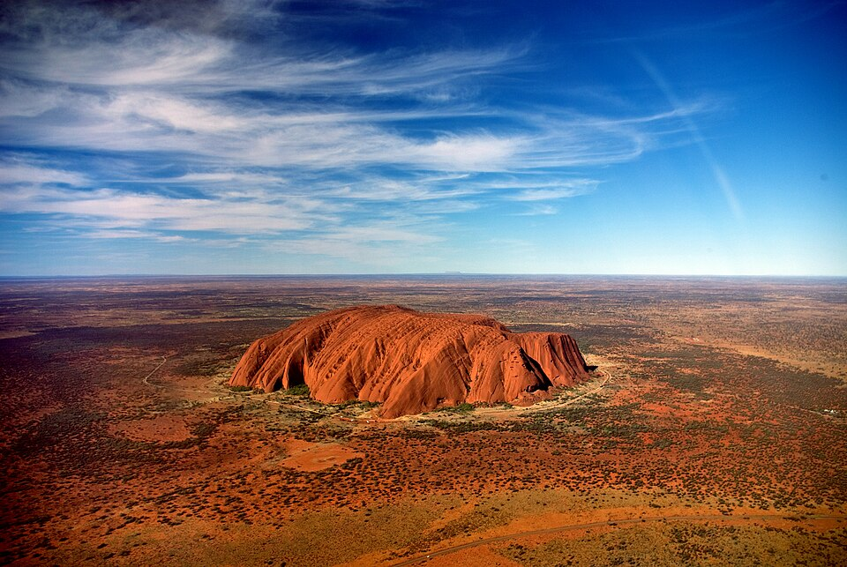
GOD IS ABLE
Romans 4
GICF 4 October 2026
The question is a logical paradox; God’s omnipotence does not include performing self-contradictory acts.
Married bachelor, square circle

Slide 4
God is able
Romans 4
GICF
4 October 2026

Slide 5
The story so far…
Ch 1 – Not ashamed of the Gospel, which begins with bad news - God’s wrath
Ch 2–3 ‘Good’ people are under God’s wrath, too. Not good enough!
Ch 3 The gift of the Gospel – justification by faith
Ch 4 What is Faith?
Romans 4

Slide 6
Today’s objectives
  Expose false faith
  Embrace true faith
  Commit to at least one step of obedient faith

Slide 7
God is able
What Abraham found
Romans 4
GICF
4 October 2026

Slide 8
Romans 4
Abraham Justified by Faith
What then shall we say that Abraham our father has found according to the flesh? ² For if Abraham was justified by works, he has something to boast about, but not before God. ³ For what does the Scripture say? “Abraham believed God, and it was accounted to him for righteousness.” ⁴ Now to him who works, the wages are not counted as grace but as debt.
Faith = imputed righteousness v3 (v22, 24)

Slide 9
Romans 4
David Celebrates the Same Truth
⁵ But to him who does not work but believes on Him who justifies the ungodly, his faith is accounted for righteousness, ⁶ just as David also describes the blessedness of the man to whom God imputes righteousness apart from works:
⁷ “Blessed are those whose lawless deeds are forgiven, and whose sins are covered;
⁸ Blessed is the man to whom the Lord shall not impute sin.”

Slide 10
Romans 4
Abraham Justified Before Circumcision
⁹ Does this blessedness then come upon the circumcised only, or upon the uncircumcised also? For we say that faith was accounted to Abraham for righteousness. ¹⁰ How then was it accounted? While he was circumcised, or uncircumcised? Not while circumcised, but while uncircumcised. ¹¹ And he received the sign of circumcision, a seal of the righteousness of the faith which he had while still uncircumcised, that he might be the father of all those who believe, though they are uncircumcised, that righteousness might be imputed to them also, ¹² and the father of circumcision to those who not only are of the circumcision, but who also walk in the steps of the faith which our father Abraham had while still uncircumcised.
2. Faith = painful obedience v11

Slide 11
Romans 4
The Promise Granted Through Faith
¹³ For the promise that he would be the heir of the world was not to Abraham or to his seed through the law, but through the righteousness of faith. ¹⁴ For if those who are of the law are heirs, faith is made void and the promise made of no effect, ¹⁵ because the law brings about wrath; for where there is no law there is no transgression.

Slide 12
Romans 4
¹⁶ Therefore it is of faith that it might be according to grace, so that the promise might be sure to all the seed, not only to those who are of the law, but also to those who are of the faith of Abraham, who is the father of us all ¹⁷ (as it is written, “I have made you a father of many nations”) in the presence of Him whom he believed—God, who gives life to the dead and calls those things which do not exist as though they did;

Slide 13
Romans 4
¹⁸ who, contrary to hope, in hope believed, so that he became the father of many nations, according to what was spoken, “So shall your descendants be.” ¹⁹ And not being weak in faith, he did not consider his own body, already dead (since he was about a hundred years old), and the deadness of Sarah’s womb. ²⁰ He did not waver at the promise of God through unbelief, but was strengthened in faith, giving glory to God,
3. Faith = strength received v20

Slide 14
Romans 4
²¹ and being fully convinced that what He had promised He was also able to perform. ²² And therefore “it was accounted to him for righteousness.”
4. Faith = fully convinced that GOD IS ABLE

Slide 15
Romans 4
²³ Now it was not written for his sake alone that it was imputed to him, ²⁴ but also for us. It shall be imputed to us who believe in Him who raised up Jesus our Lord from the dead, ²⁵ who was delivered up because of our offenses, and was raised because of our justification.
5. Faith = to believe in the God who…v24

Slide 16
I. FALSE Faith

Slide 17
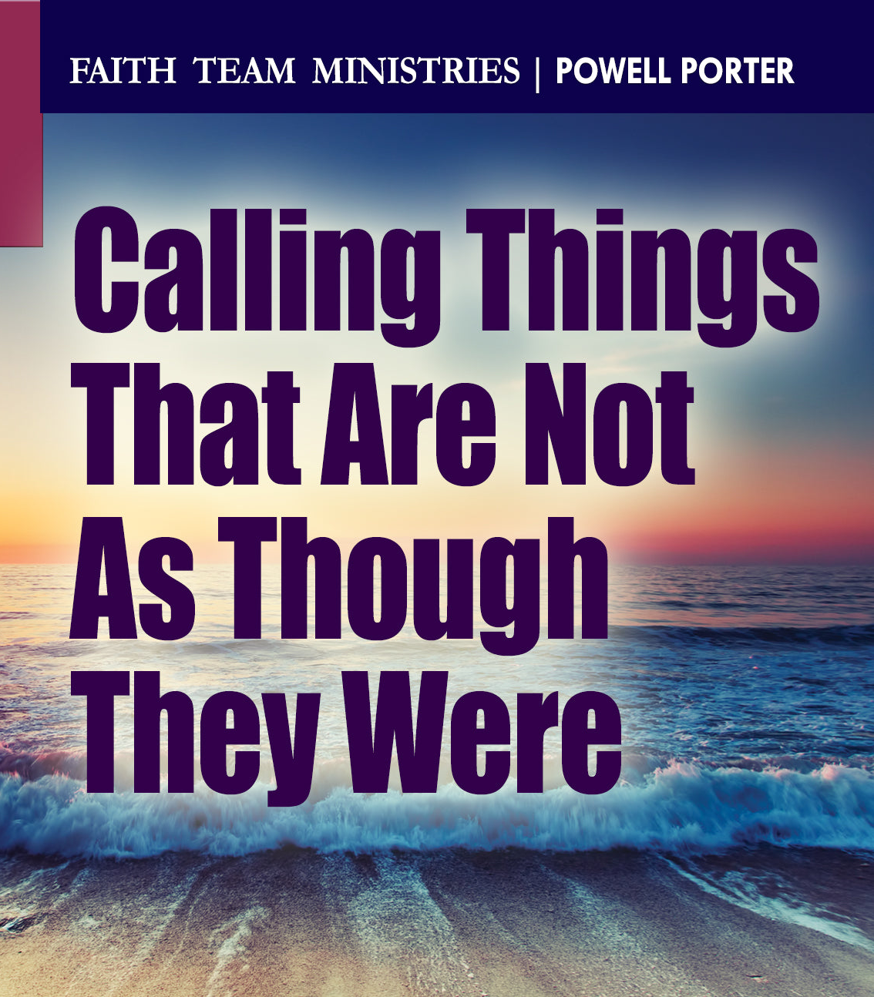
Romans 4:16-17
¹⁶ Therefore it is of faith …17 in the presence of Him whom he believed—God, who gives life to the dead and calls those things which do not exist as though they did

Slide 18
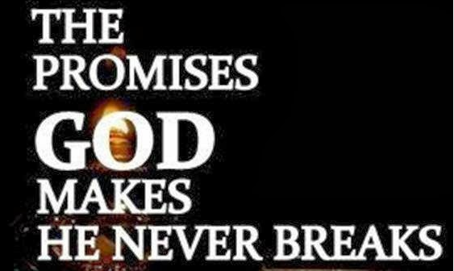
Promises God didn't make
Power to create reality by speaking — “Speak it into existence”
Guaranteed wealth
Perfect physical health
Healing on demand if you “activate” faith
A life without suffering (’suffering = weak faith’)
Success in every project
Protection from all harm
Guaranteed relationship success — perfect marriages, obedient children, etc.
Guaranteed promotion or influence
Guaranteed miracles if you sow money “Seed-faith”
Guaranteed avoidance of persecution
Guaranteed comfort & luxury

Slide 19
Promises God didn't make
Unbiblical promises create
false expectations
- self‑blame when suffering comes
- disillusionment with God
a distorted view of discipleship
True discipleship = becoming more like the master, not becoming more comfortable!

Slide 20
II. TRUE FAITH

Slide 21
Biblical promises God did make
Forgiveness of sins
Eternal life
The Holy Spirit
Wisdom when asked James 1:5
God’s presence I will never leave you nor...
Peace that guards the heart Not the absence of trouble, but supernatural peace in trouble.
Strength in weakness —sustaining grace, not self‑sufficiency. “My strength is made perfect in weakness.”
Provision for needs
Comfort in suffering, not the removal of all pain.
Justice - in the end
Sanctification and transformation — He will complete the good work He began in you!
Answered prayer- prayer aligned with His will, character, and purposes.
Suffering for Christ — “All who desire to live godly lives… will be persecuted.” 2 Timothy 3:12
Christ’s return

Slide 22
What Abraham Found
¹¹ And he received the sign of circumcision, a seal of the righteousness of the faith which he had while still uncircumcised, that he might be the father of all those who believe, though they are uncircumcised, that righteousness might be imputed to them also, ¹² and the father of circumcision to those who not only are of the circumcision, but who also walk in the steps of the faith which our father Abraham had while still uncircumcised.

Slide 23
Steps of Faith – What Abraham found
Faith = imputed righteousness v3 (v22, 24)
Faith = painful obedience v11
Faith = strength received v20
Faith = fully convinced that GOD IS ABLE v21
Faith = to believe in the God who…v24

Slide 24
What have I found?
If I have faith in the God who raised Jesus, (who died for my offenses, and was raised because of my justification), then
I am forgiven & righteous
I will obey by faith
I will receive strength
& I will see that God is able to keep His promises

Slide 25
Why faith?
Hebrews 11:6
But without faith it is impossible to please Him, for he who comes to God must believe that He is, and that He is a rewarder of those who diligently seek Him.

Slide 26
GOD IS ABLE
Conclusion
Faith says that
GOD IS ABLE
so
I will walk in the steps of faith
I will obey today
I will share the good news

Slide 27
Discussion
How does true faith help & false faith harm us?
Youth Question
Which of the points of true faith is hardest for you to identify with? Why?
Faith = imputed righteousness v3 (v22, 24)
Faith = painful obedience v11
Faith = strength received v20
Faith = fully convinced that GOD IS ABLE v21
Faith = to believe in the God who…v24

