Slide 1
The Results of Faith
Romans 5:1-11

Slide 2
If I believe in Jesus, what do I get?

Slide 3

What does God promise to those who have faith in Him?

Slide 4
“Therefore, since we have been justified by faith, we have…”
- Romans 5:1

Slide 5
Romans 5:1-11
1 Therefore, since we have been justified by faith, we have peace with God through our Lord Jesus Christ.
2 Through him we have also obtained access by faith into this grace in which we stand, and we rejoice in hope of the glory of God.
3 Not only that, but we rejoice in our sufferings, knowing that suffering produces endurance

Slide 6
4 and endurance produces character, and character produces hope,
5 and hope does not put us to shame, because God's love has been poured into our hearts through the Holy Spirit who has been given to us.
6 For while we were still weak, at the right time Christ died for the ungodly.
7 For one will scarcely die for a righteous person—though perhaps for a good person one would dare even to die—

Slide 7
8 but God shows his love for us in that while we were still sinners, Christ died for us.
9 Since, therefore, we have now been justified by his blood, much more shall we be saved by him from the wrath of God.
10 For if while we were enemies we were reconciled to God by the death of his Son, much more, now that we are reconciled, shall we be saved by his life.
11 More than that, we also rejoice in God through our Lord Jesus Christ, through whom we have now received reconciliation.

Slide 8

Result #1 - Peace with god
Romans 5:1 Therefore, since we have been justified by faith, we have peace with God through our Lord Jesus Christ.
Luke 2:14 “Glory to God in the highest, and on earth peace among those with whom he is pleased!”

Slide 9
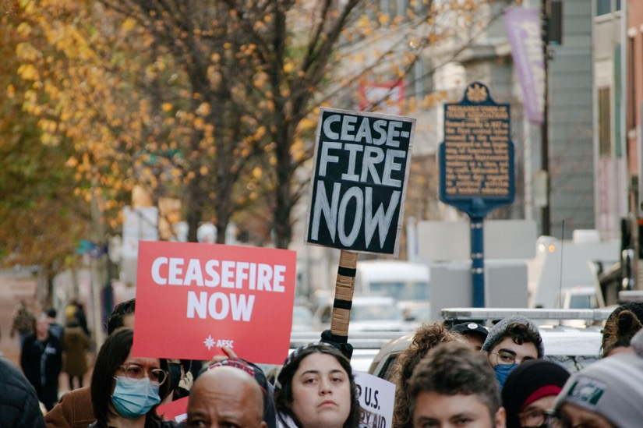
Result #1 - Peace with god
More than a ceasefire

Slide 10
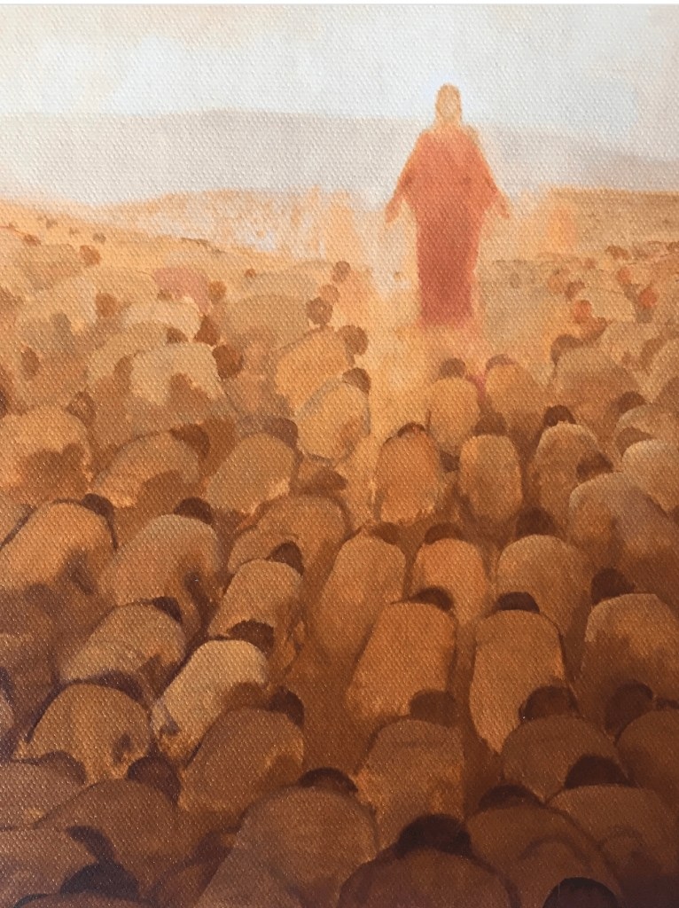
Result #1 - Peace with god
Condition: Acknowledge Him as King

Slide 11
Result #2 - hope
Romans 5:2 - We rejoice in hope of the glory of God.
1 Peter 1:3-4 - According to his great mercy, he has caused us to be born again to a living hope through the resurrection of Jesus Christ from the dead, to an inheritance that is imperishable, undefiled, and unfading, kept in heaven for you.

Slide 12
Result #2 - hope
Hoping in this world:
Outcome #1
(you don’t get the thing):
Disappointment
Outcome #2
(you get the thing):
Disappointment

Slide 13
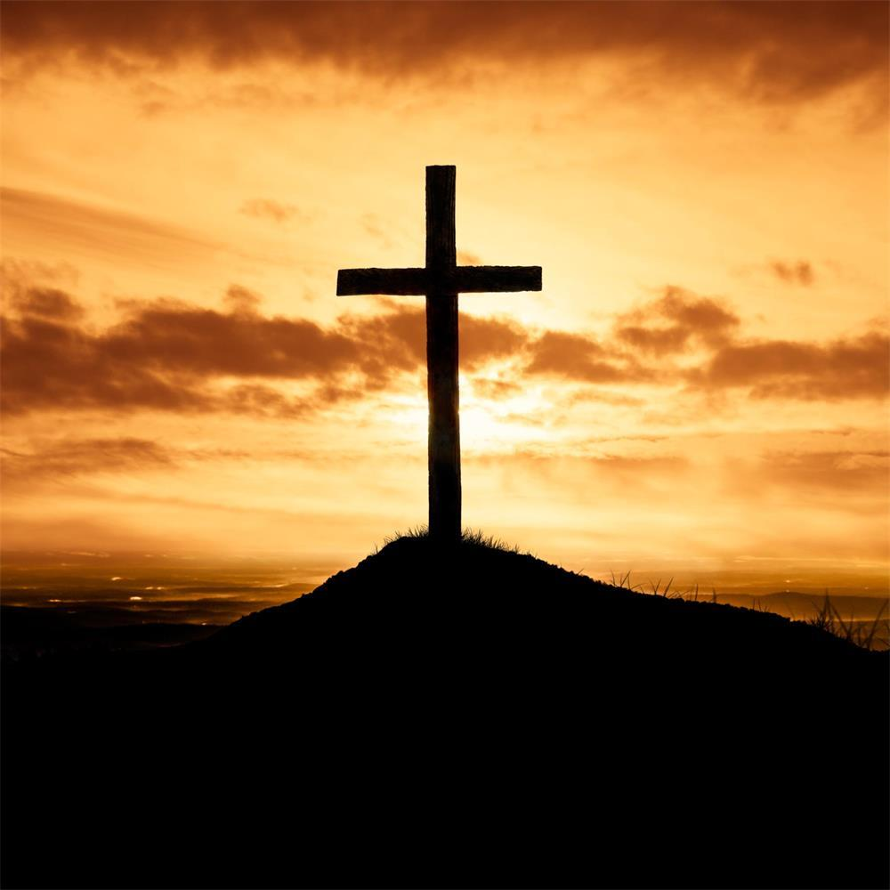
Result #2 - hope
Set your hope in Christ

Slide 14
Result #2 - Hope
When was the last time you prayed for the second coming?

Slide 15
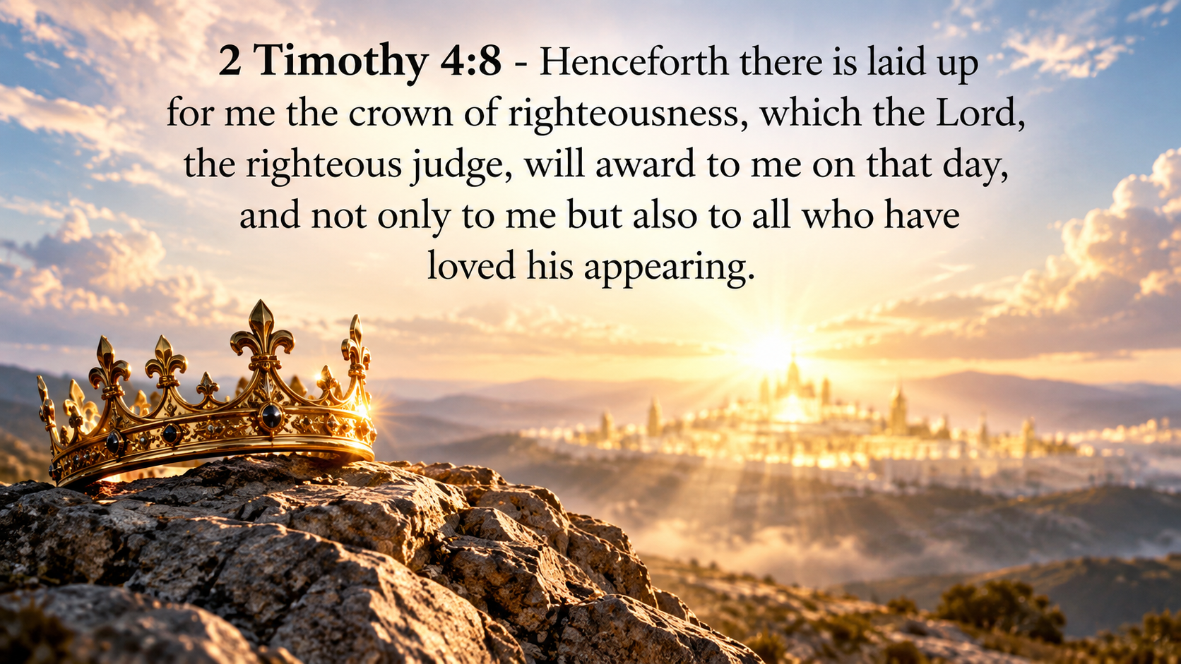

Slide 16
Result #3 - ENDURANCE
Romans 5:3-4 - Not only that, but we rejoice in our sufferings, knowing that suffering produces endurance, and endurance produces character, and character produces hope.
Suffering produces endurance

Slide 17
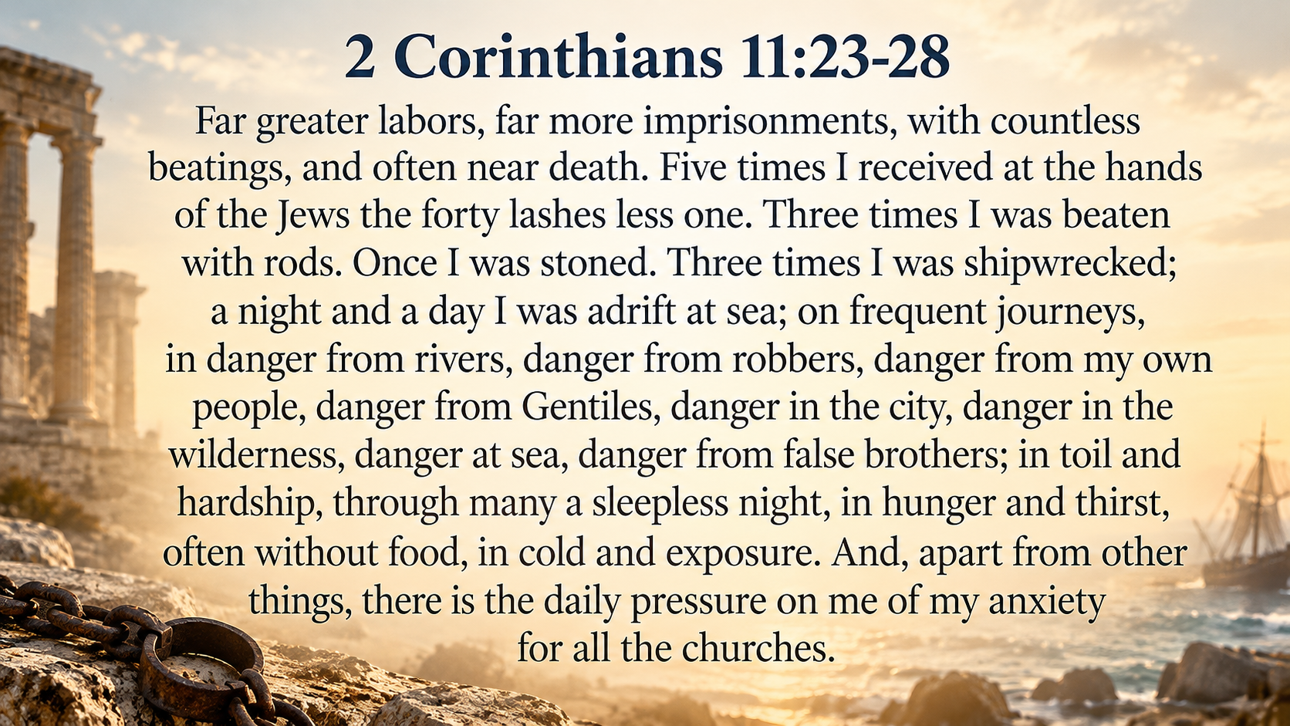

Slide 18
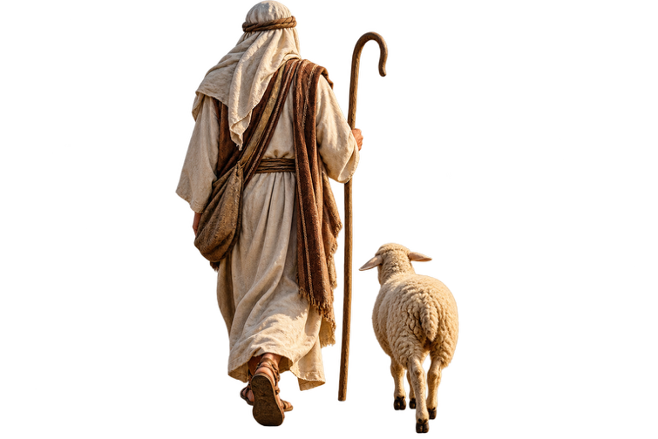
Result #3 - Endurance
God never promises that we will not experience difficulties, but he does promise to be with us.

Slide 19
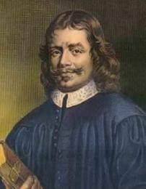
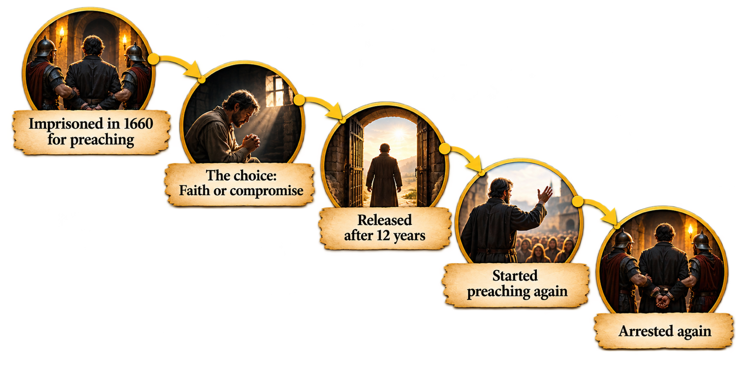
John bunyan

Slide 20
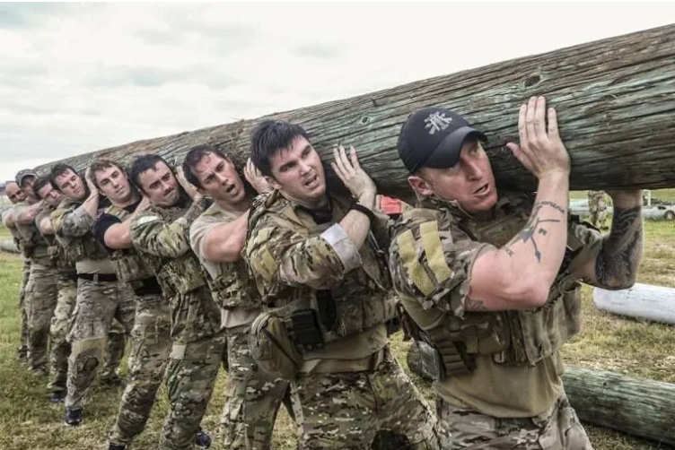
Result #3 - Endurance
Suffering produces either
ENUDRANCE or QUIT

Slide 21

Therefore, since we are surrounded by so great a cloud of witnesses, let us also lay aside every weight, and sin which clings so closely, and let us run with endurance the race that is set before us, looking to Jesus
Hebrews 12:1-2

Slide 22
Result #3 - Endurance
When facing suffering, ask
“WHAT IS GOD TRYING TO TEACH ME?”

Slide 23
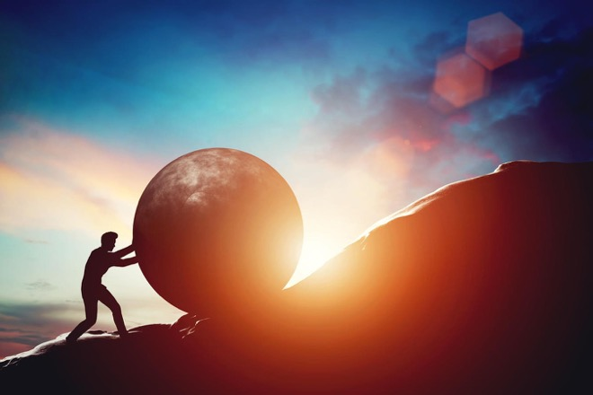
Result #4 - Character
Romans 5:4 – endurance produces character, and character produces hope
James 1:3-4 - For you know that the testing of your faith produces steadfastness. And let steadfastness have its full effect, that you may be perfect and complete, lacking in nothing.

Slide 24
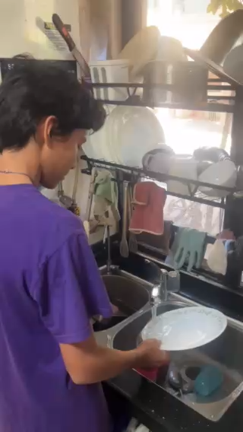
Endurance produces character

Slide 25
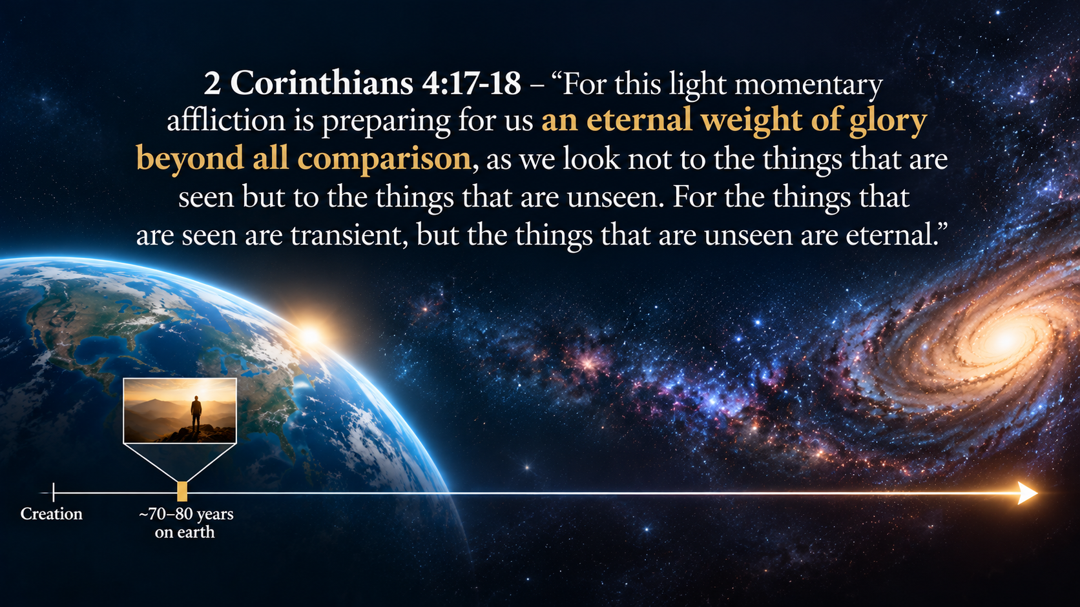

Slide 26
Rate yourself 1-5
When things are difficult, I remain thankful and joyful rather than complain.
When life is difficult, I look to God and persevere rather than giving up.
When facing difficulties, I continue to trust God rather than give in to the thinking that He has abandoned me.
I can see clear growth in my character in the past year.
I can look back and see times when God has used difficulties to shape my character.

Slide 27
Result #5 - salvation
God’s love has been poured out (5)
Christ died for the ungodly (6)
While we were still sinners, Christ died for us (8)
We have now been justified by His blood (9)
We… shall be saved… from the wrath of God (9)
We are reconciled (10)
We [shall be] saved by his life (11)
Through whom we have now received reconciliation (11)

Slide 28
Results of faith
Peace
Hope
Endurance
Character
Salvation

Slide 29

rejoice
Romans 5:2 - we rejoice in hope of the glory of God
Romans 5:3 - we rejoice in our sufferings
Romans 5:11 - we also rejoice in God through our Lord Jesus Christ, through whom we have now received reconciliation

Slide 30
Would people who know you describe you as joyful?

Slide 31
Discussion Questions
Share about a time when God used suffering or difficulties to grow your character. What did you learn about God? How did you grow?

