Slide 1

What Adam Ruined…
…Christ Redeemed
Romans Series
Guangzhou International Christian Fellowship
October 18, 2026
Scripture verses taken from the New King James Version (NKJV)

Slide 2
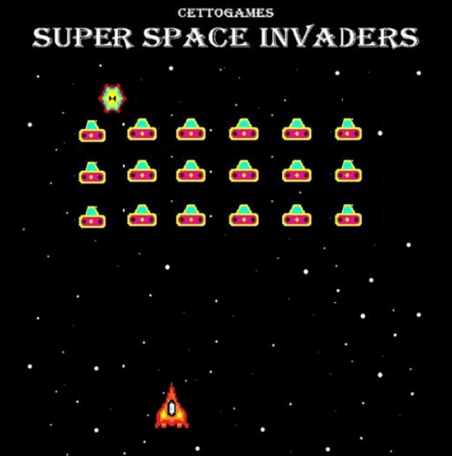
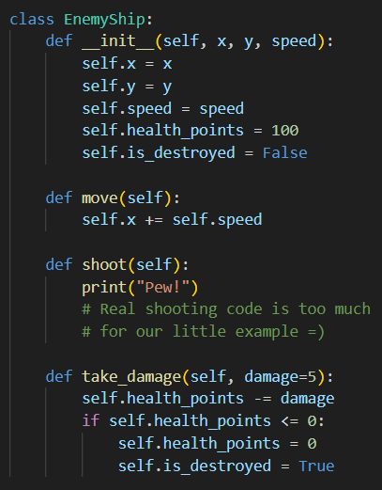

Slide 3
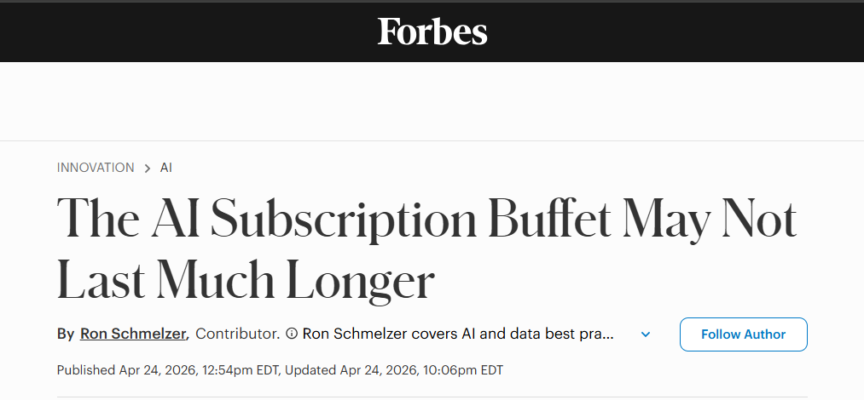

Slide 4

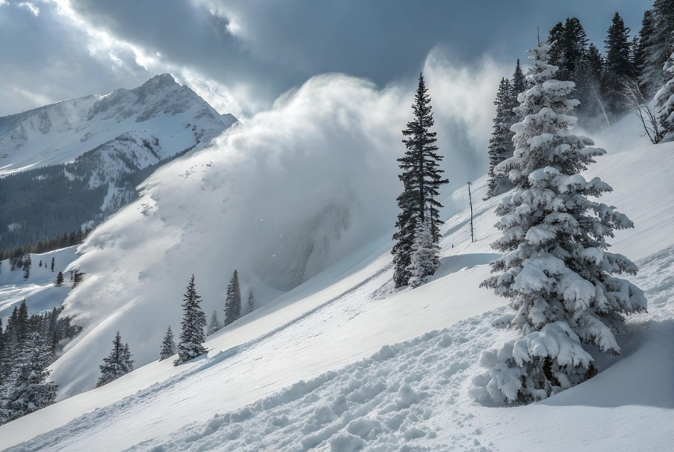
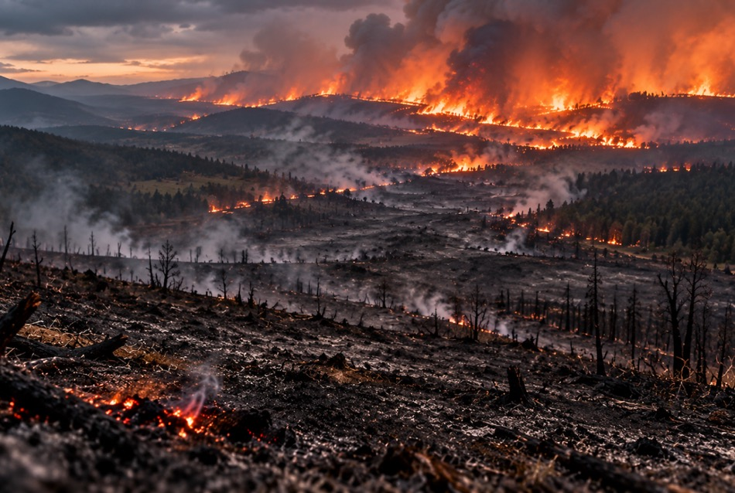
Work was finished.
Cost kept pouring in.

Slide 5
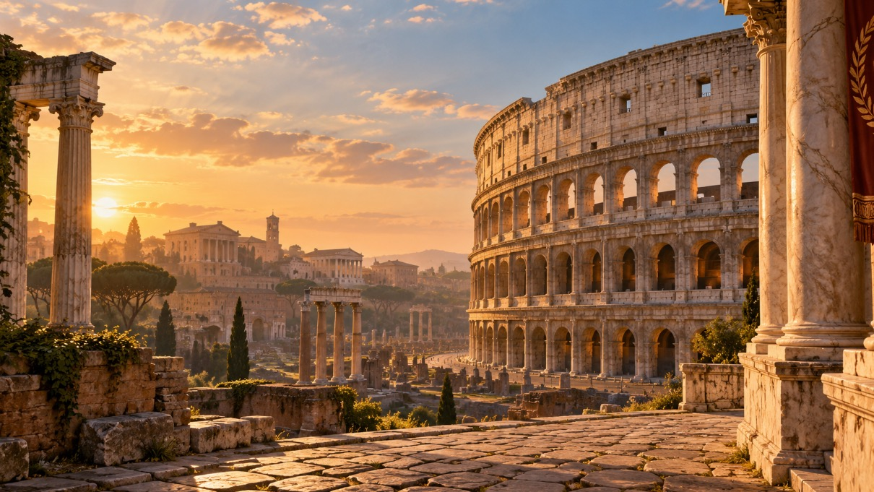
Romans Recap

Slide 6

2 Peter 3:15-16
¹⁵ and consider that the longsuffering of our Lord is salvation—as also our beloved brother Paul, according to the wisdom given to him, has written to you, ¹⁶ as also in all his epistles, speaking in them of these things, in which are some things hard to understand, which untaught and unstable people twist to their own destruction, as they do also the rest of the Scriptures.

Slide 7
2 Peter 3:18
¹⁸ but grow in the grace and knowledge of our Lord and Savior Jesus Christ.

Slide 8
What Adam Ruined…

Slide 9
Romans 5:12-14
¹² Therefore, just as through one man sin entered the world, and death through sin, and thus death spread to all men, because all sinned— ¹³ (For until the law sin was in the world, but sin is not imputed when there is no law. ¹⁴ Nevertheless death reigned from Adam to Moses, even over those who had not sinned according to the likeness of the transgression of Adam, who is a type of Him who was to come.

Slide 10
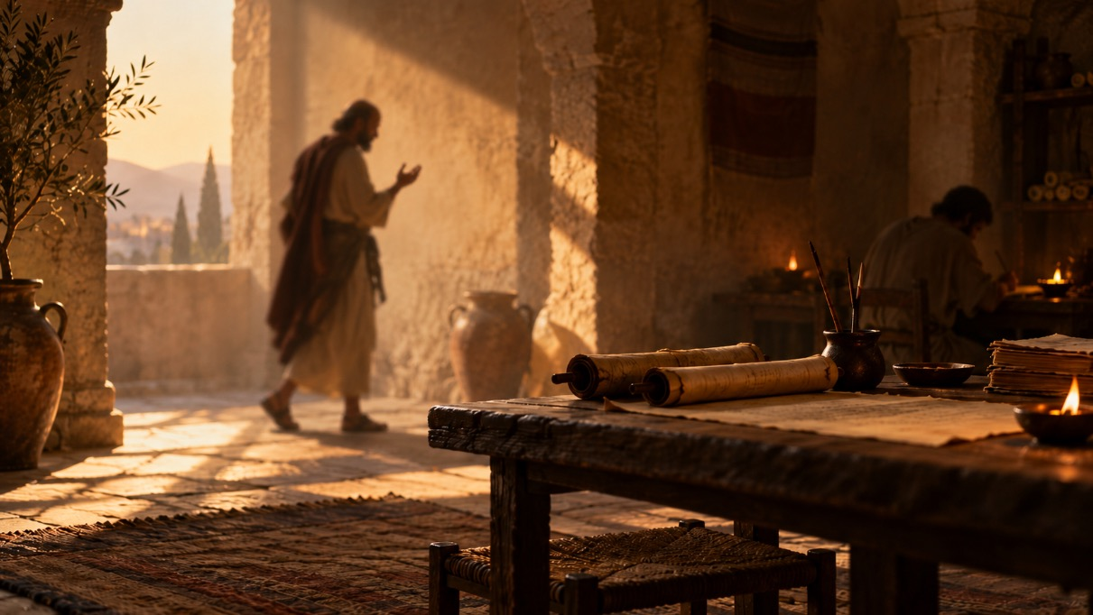
A few questions to consider before the AI Workshop…
What was it like to think and communicate when writing took time and money, and messages could take days or weeks to arrive? How might that have shaped the way people developed and expressed their ideas?
To what extent do you think Paul made use of the technology and communication systems available in his day?
What happens when the same technology that helps spread truth can also be used to imitate, distort, or fake it? Did Paul ever face that problem?

Slide 11

1. Adam Sinned

Slide 12
Genesis 2:16-17
¹⁶ And the Lord God commanded the man, saying, “Of every tree of the garden you may freely eat; ¹⁷ but of the tree of the knowledge of good and evil you shall not eat, for in the day that you eat of it you shall surely die.”

Slide 13
Genesis 3:6-7
⁶ So when the woman saw that the tree was good for food, that it was pleasant to the eyes, and a tree desirable to make one wise, she took of its fruit and ate. She also gave to her husband with her, and he ate. ⁷ Then the eyes of both of them were opened, and they knew that they were naked; and they sewed fig leaves together and made themselves coverings.

Slide 14
2. Humanity Inherits Adam’s Sinful Nature

Slide 15
Genesis 1:26a; 5:1-3
²⁶ Then God said, “Let Us make man in Our image, according to Our likeness…”
¹ This is the book of the genealogy of Adam. In the day that God created man, He made him in the likeness of God. ² He created them male and female, and blessed them and called them Mankind in the day they were created. ³ And Adam lived one hundred and thirty years, and begot a son in his own likeness, after his image, and named him Seth.

Slide 16

Humanity Inherits Adam’s Sinful Nature
Behold, I was brought forth in iniquity,
And in sin my mother conceived me.
  Psalm 51:5
And you He made alive, who were dead in trespasses and sins…and were by nature children of wrath, just as the others.
  Ephesians 2:1,3b

Slide 17
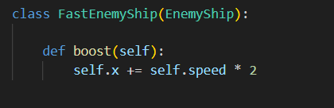

“Inheritance”
Fast Enemy Ship “inherits” all the attributes of Enemy Ship

Slide 18
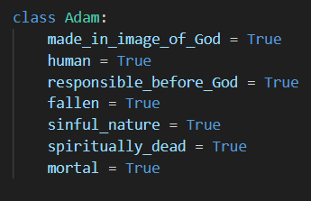
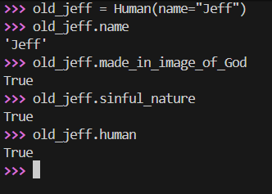
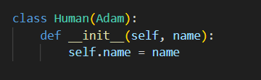
“Inheritance”
In the code example, all of “Adam’s” properties are inherited by the “Human” class.
Spiritually, we inherit Adam’s sinful nature and other attributes.

Slide 19
3. One Man’s Sin Infected the Whole Family Tree

Slide 20

“And I will put enmity
Between you and the woman,
And between your seed and her Seed;
He shall bruise your head,
And you shall bruise His heel.”
Genesis 3:15

Slide 21
…Christ Redeemed

Slide 22
Romans 5:15
¹⁵ But the free gift is not like the offense. For if by the one man’s offense many died, much more the grace of God and the gift by the grace of the one Man, Jesus Christ, abounded to many.

Slide 23
Romans 5:16-17
¹⁶ And the gift is not like that which came through the one who sinned. For the judgment which came from one offense resulted in condemnation, but the free gift which came from many offenses resulted in justification. ¹⁷ For if by the one man’s offense death reigned through the one, much more those who receive abundance of grace and of the gift of righteousness will reign in life through the One, Jesus Christ.)

Slide 24
Romans 5:18-19
¹⁸ Therefore, as through one man’s offense judgment came to all men, resulting in condemnation, even so through one Man’s righteous act the free gift came to all men, resulting in justification of life. ¹⁹ For as by one man’s disobedience many were made sinners, so also by one Man’s obedience many will be made righteous.

Slide 25
Romans 5:20-21
²⁰ Moreover the law entered that the offense might abound. But where sin abounded, grace abounded much more, ²¹ so that as sin reigned in death, even so grace might reign through righteousness to eternal life through Jesus Christ our Lord.

Slide 26

1. Christ Was the Perfect Sacrifice

Slide 27
Hebrews 4:15
¹⁵ For we do not have a High Priest who cannot sympathize with our weaknesses, but was in all points tempted as we are, yet without sin.

Slide 28
2. Christ’s Sacrifice Covers All Sin

Slide 29
John 1:12-13
¹² But as many as received Him, to them He gave the right to become children of God, to those who believe in His name: ¹³ who were born, not of blood, nor of the will of the flesh, nor of the will of man, but of God.

Slide 30
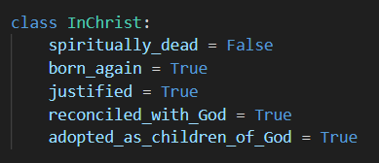

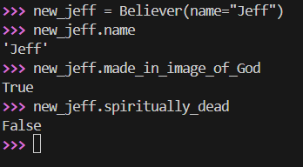
“Multiple Inheritance”
*
* Technical detail: In Python, if multiple parent classes define the same attribute, the one listed first takes precedence. So here, “spiritually_dead = False” (i.e., spiritually alive) from InChrist overrides the value inherited from Adam.

Slide 31
¹⁸ Therefore, as through one man’s offense judgment came to all men, resulting in condemnation, even so through one Man’s righteous act the free gift came to all men, resulting in justification of life. ¹⁹ For as by one man’s disobedience many were made sinners, so also by one Man’s obedience many will be made righteous.

Slide 32
²⁰ Moreover the law entered that the offense might abound. But where sin abounded, grace abounded much more, ²¹ so that as sin reigned in death, even so grace might reign through righteousness to eternal life through Jesus Christ our Lord.

Slide 33
What Adam Ruined…
…Christ Redeemed

Slide 34
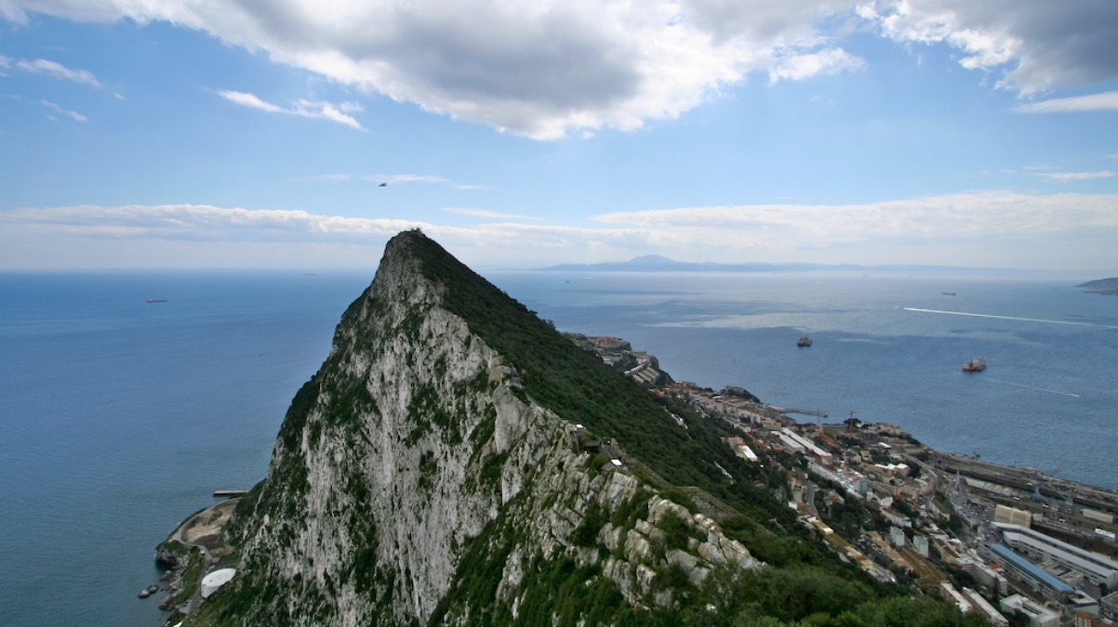
“Pillars of Hercules”

Slide 35
2 Peter 3:18
¹⁸ but grow in the grace and knowledge of our Lord and Savior Jesus Christ.

Slide 36
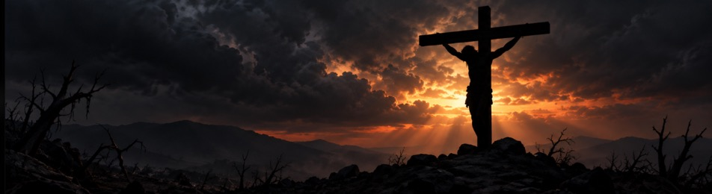

One work finished.
…Christ Redeemed
Cost keeps pouring in...
Grace keeps flowing on...
What Adam Ruined…

Slide 37

Discussion Question
What would it mean practically to you to live this week as someone who belongs to Christ rather than simply living according to what we inherited from Adam?

