Slide 1


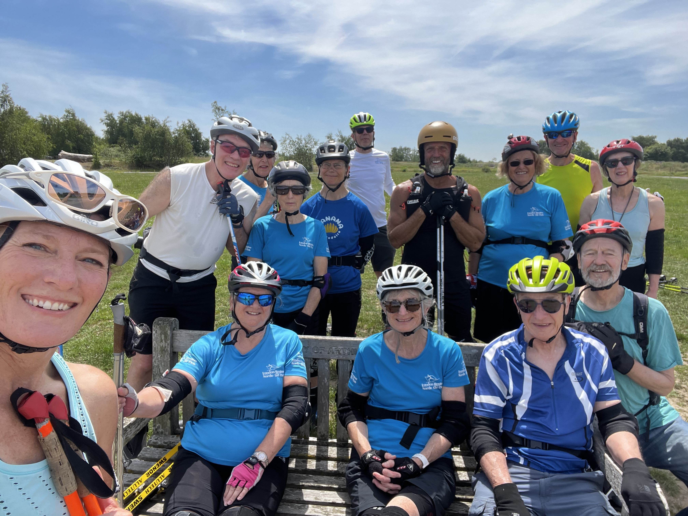
LRNSC AGM 2026 • KENT CLUB SUMMARY
Annual Reach & Participation Highlights
14
100+
25
10
Rollerski Sessions
Total Reach
Taster Sessions
Youth Skiers
Participant Motivations
Improve Fitness
60%
Ski Holiday / Event Preparation
50%
Enjoy Outdoor Activity
50%
Try a New Sport
40%
4.9 / 5.0
90% 5-Star Ratings
Exceptional satisfaction driven by tailored technical coaching and visible skill progression.

Slide 2



AGM 2026 REVIEW • FEEDBACK & STRATEGY
Coaching Impact & Roadmap
Coaching Impact
Future Format Demand
What’s next
Snow Crossover: Direct technique transfer improving snow performance
Coached Adult Progression
90%
Specialisation: Separate Classic and Skate training slots.
Tailored Tuition: Person-centred instruction for all abilities
Classic-Focused Sessions
50%
Structure: Separate sessions focused on building confidence and higher intensity.
Skate-Focused Sessions
50%
Venue Quality: Betteshangar ideal for safe training
Promotion: Partner with Betteshangar & local press for outreach.
Social / Recreational
50%

