Slide 1

Energy Efficiency for
Ashton Hayes

Slide 2
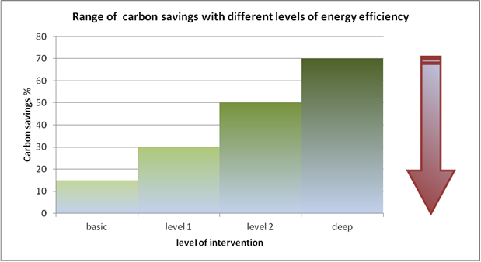

What we are aiming for

Slide 3
The levels
Boiler Upgrade/ replacement
Secondary glazing
Loft Insulation
Cavity wall filling
Solar thermal
Draught proofing and door seals
Low energy light bulbs
Energy Efficient Appliances
Standby Sensors
Energy monitors
Boiler services
Behavioural Training and Instruction
Window and Door Replacements
Triple glazing upgrades
Replacement heating systems
External Insulation
Internal wall Insulation
Sloping ceiling insulation
Whole House Ventilation Systems with Heat Recovery
Re-roofing and Roofing Upgrades Rainwater Harvesting
Installation of Renewables

Slide 4
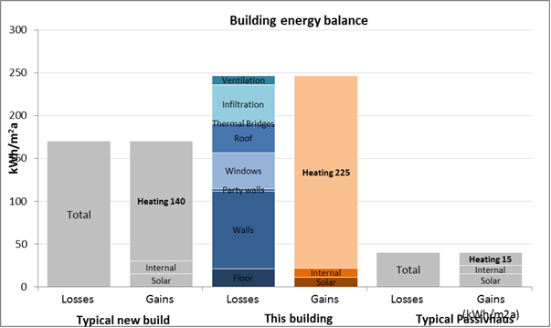
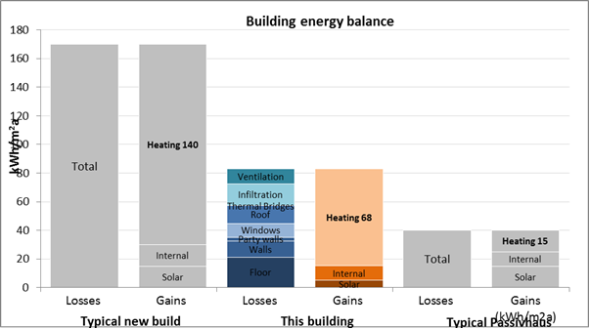
House 1 Energy Reduction

Slide 5
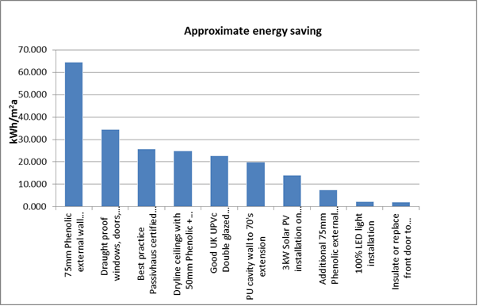
Energy Savings House 1

Slide 6
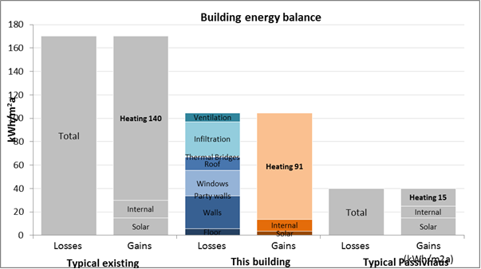
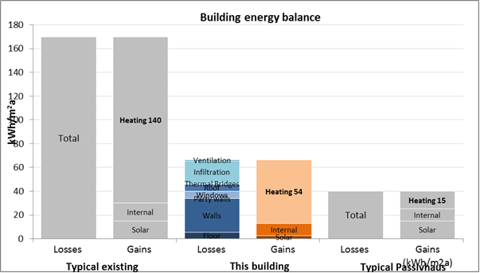
House 2 Energy Reduction

Slide 7
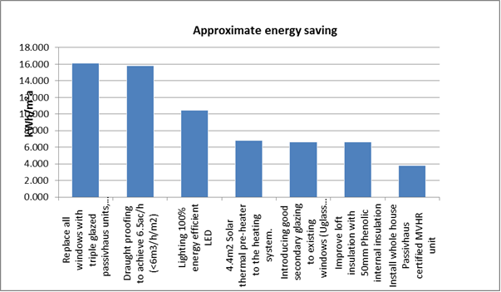
Energy Savings House 2

